Slide 1
נ.נ. בתכנון משולב חומרה/תוכנה אביב – 00460882 תרגול 5 – מטמונים ועוד...
אוהד איתן

Slide 2
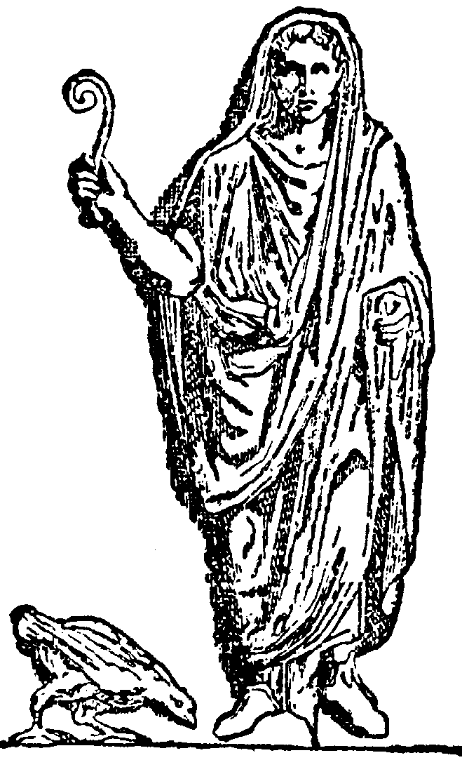
Augury: Using Data Memory-Dependent Prefetchers to Leak Data at Rest
J. R. S. Vicarte et al., "Augury: Using Data Memory-Dependent Prefetchers to Leak Data at Rest," 2022 IEEE Symposium on Security and Privacy (SP), San Francisco, CA, USA, 2022, pp. 1491-1505, doi: 10.1109/SP46214.2022.9833570.​

Slide 3
Agenda
What is a side-channel attack (SCA)
Classical and DMP prefetchers
Proving the existence of DMP
Attacks POC
Mitigations
Personal View

Slide 4
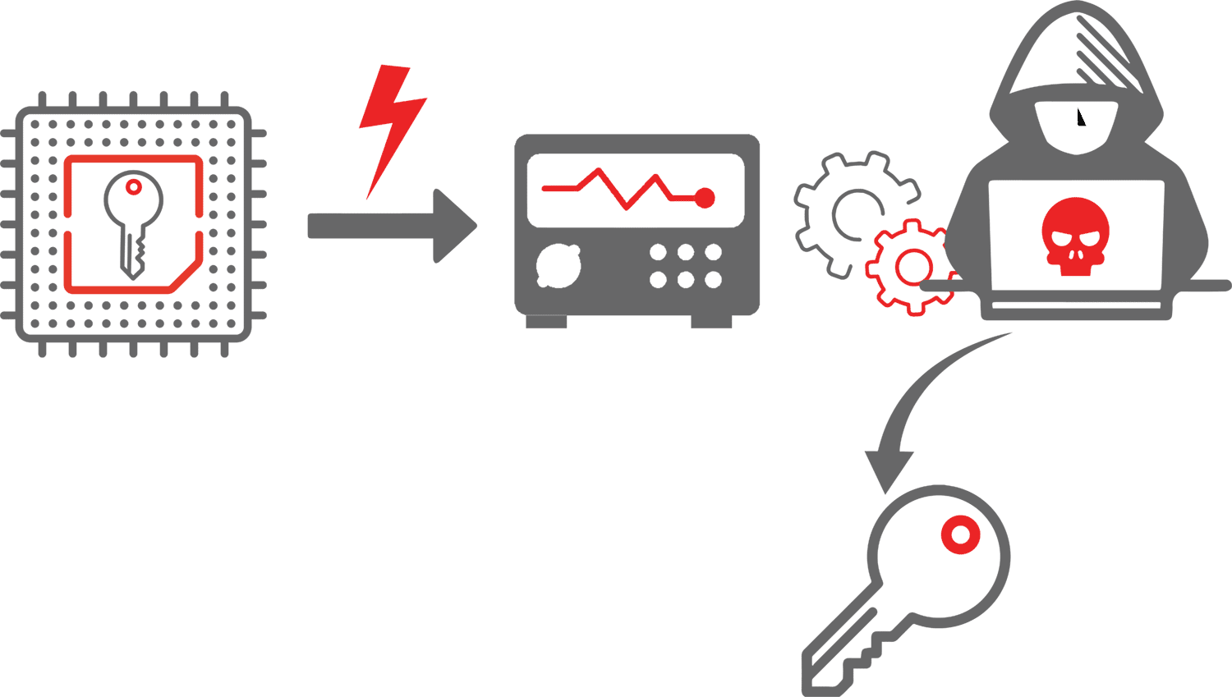

SCA In a Nutshell
What: Targets the physical implementation of a computer system
How: Timing, Power Analysis, Cache…
Why: Cannot simply patch a side channel like a software bug. It is intrinsic to the hardware
Notes:
נושא חם מאוד – מתוך רצון לאפטם דברים זולג מידע לערוצי צד
לתת על הלוח דוגמה לכל אחד
Timing:
For I in index((len)pwd): if try[c] != pwd[c] return
Cache:
If idx < len(arr):
Print(arr[idx])
עד עכשיו ההתקפות בוצעו רק עבור
Data in use
אפשר מיטיגציה נגיד עבור
constant-time-programming

Slide 5
Prime + Probe
1
PRIME
Attacker fills target cache set with own data, ensuring every line belongs to attacker.
2
WAIT
Victim executes (speculatively or not). If victim accesses an address mapping to that cache set, it evicts one of the attacker's lines.
3
PROBE
Attacker re-accesses its own data. A cache miss (slow access) reveals the victim touched that cache set, leaking address information.

Slide 6
Spectre: Cache Side Channel
L1 Cache Sets
Why Prime+Probe Works
Set 0: Attacker
Cache is indexed by physical address bits
Attacker controls which sets it fills (PRIME)
Victim's speculative access evicts attacker data
Timing the PROBE step reveals which set was evicted
Set 1: Attacker
Set 2: Victim (evicted)
Set 3: Attacker

Slide 7
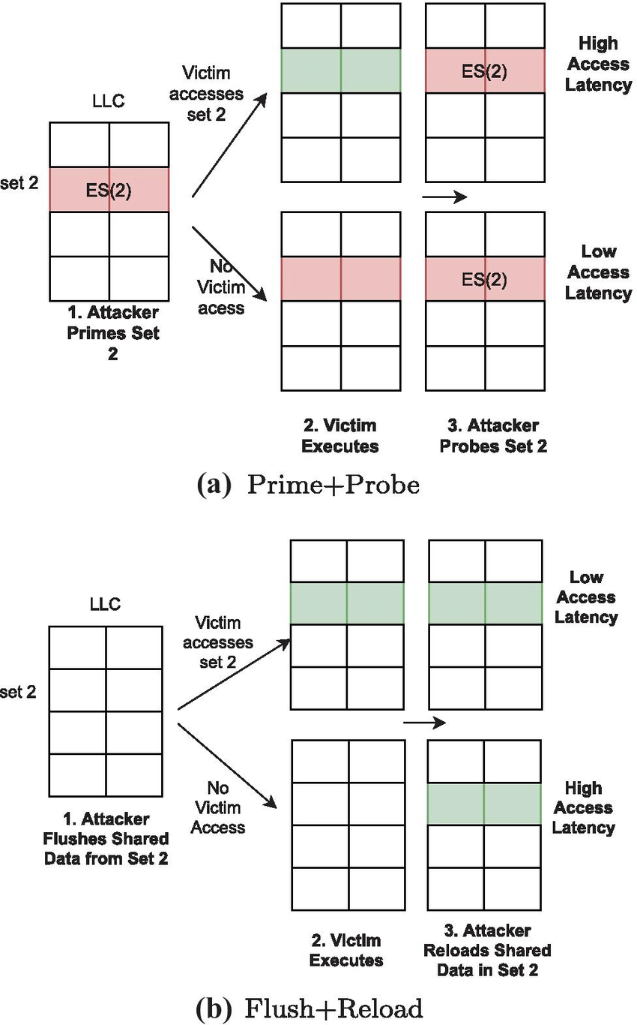
Spectre: Cache Side Channel

Slide 8
Flush + Reload
1
FLUSH
Attacker uses CLFLUSH to evict the cache
2
SPECULATE
A load reads a kernel byte (secret) and accesses probe_array[secret × 4096]. The CPU faults, but the load completes speculatively.
3
RELOAD
Attacker times access to each of the 256 probe array pages. The one page that loads fast (cache hit) reveals the value of the secret byte.

Slide 9
Meltdown: Execution Window
Transient Code Sequence
What Happens
rcx = kernel address
rbx = probe array base
mov al, [rcx]
↑ faults, but executes
speculatively first
shl rax, 12
secret × 4096
mov rbx, [rbx + rax]
cache probe_array[s]
1. CPU issues the kernel load out-of-order before checking permissions
2. Secret byte flows into dependent instructions during the transient window
3. Probe array page gets cached based on the secret value
4. CPU detects the fault, rolls back architectural state, but the cache state persists
5. Attacker catches the fault and runs the RELOAD step

Slide 10
Meltdown: Flush + Reload

Slide 11
SCA In a Nutshell
Notes:
Requires same physical memory page into their (possibly different) virtual address spaces
Can be a shared library

Slide 12
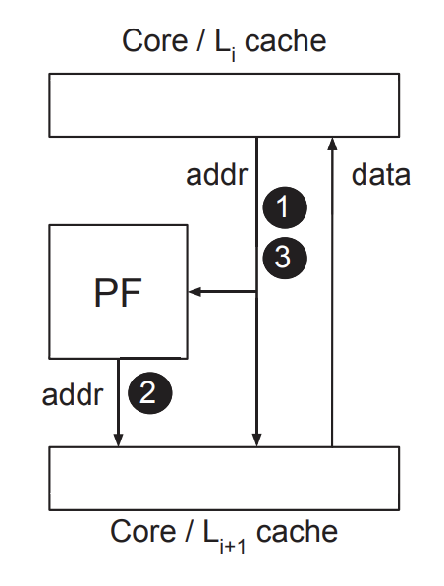

Classical Prefetchers
Step 1: Training. Checks if address sequence from core matches a specific pattern.
Step 2: Prefetching. If a pattern is recognized, fill the cache with predicted next address.
Step 3: Validation. Checks if its predictions were correct.
Prefetching depth depends on confidence. Might overshoot.
Notes:
להסביר משמעות של
cache
By default, caches will exploit temporal locality to hide the latency of repeated accesses to memory by storing data recently used by the core.
int A[M];
... // e.g., initialize A
for (i = 0 ... M) A[k*i];
for some constant stride k. Upon observing the core request addresses &A[0], &A[k], ..., &A[k*N], the prefetcher predicts that the core will request &A[k*(N+1)], ..., &A[k*(N+delta)] in the near future and proactively issues cache fills for those cache lines. Here, N is the confidence threshold: how many accesses must be seen before the prefetcher activates. delta is the depth: how far ahead the prefetcher prefetches once it activates. Depth is often directly correlated to the confidence: As more accesses are made, the prefetcher will fetch proportionally farther ahead. Importantly, prefetchers live in the memory system and are software transparent. For example, they might live between the core and level 1 (L1) cache, or between two lowerlevels (L2+) of cache. As such, they are unaware of program semantics: they only see the program address pattern and try to predict the next address. In the above code snippet, the prefetcher is unaware of the array A, its base or its bound. Thus, the prefetcher will prefetch data out of bounds of A, i.e., up to address &A[M+k*delta], before it realizes through subsequent failed validations that the program doesn’t intend to access beyond the array bounds. This will have important security implications later on.

Slide 13
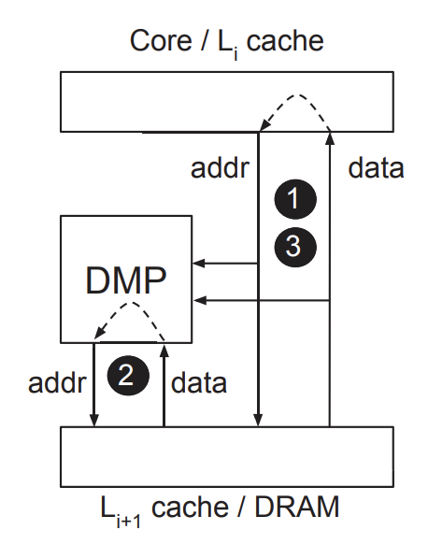
Data memory-dependent prefetchers - dmps
Step 1: Training. Checks if address sequence from core, and to core matches a specific pattern
Step 2: Prefetching.
Step 3: Validation.
Used for data dependency – turning a value into an address (chasing pointers)
DMP gets physical addresses and brings the data. That data is a pointer to the next virtual address. Hence, it must do Virtual-to-physical address translation to prefetch.
MMU
Notes:
During the train phase, the DMP monitors the data returned to the core as well as subsequent addresses and tries to determine whether the address stream is a specific function of the data returned. For example, in a pointer chase data will be directly used as an address. In the prefetch phase, the prefetcher will initiate reads to memory that follow the predicted pattern. This, crucially, requires the prefetcher to examine and act on the contents of data memory directly. For a pointer chase, the prefetcher will read a cache line that it believes contains a pointer and then dereference the pointer.
נגיד רץ על רשימה מקושרת, רואה בקשה לכתובת של המצביע לנוד הבא. הDMP
יודע שזה רשימה מקושרת אז הוא כבר מבקש את מה שיש בכתובת הזאת,
ואז מתוכה, את מה שיש בכתובת

Slide 14

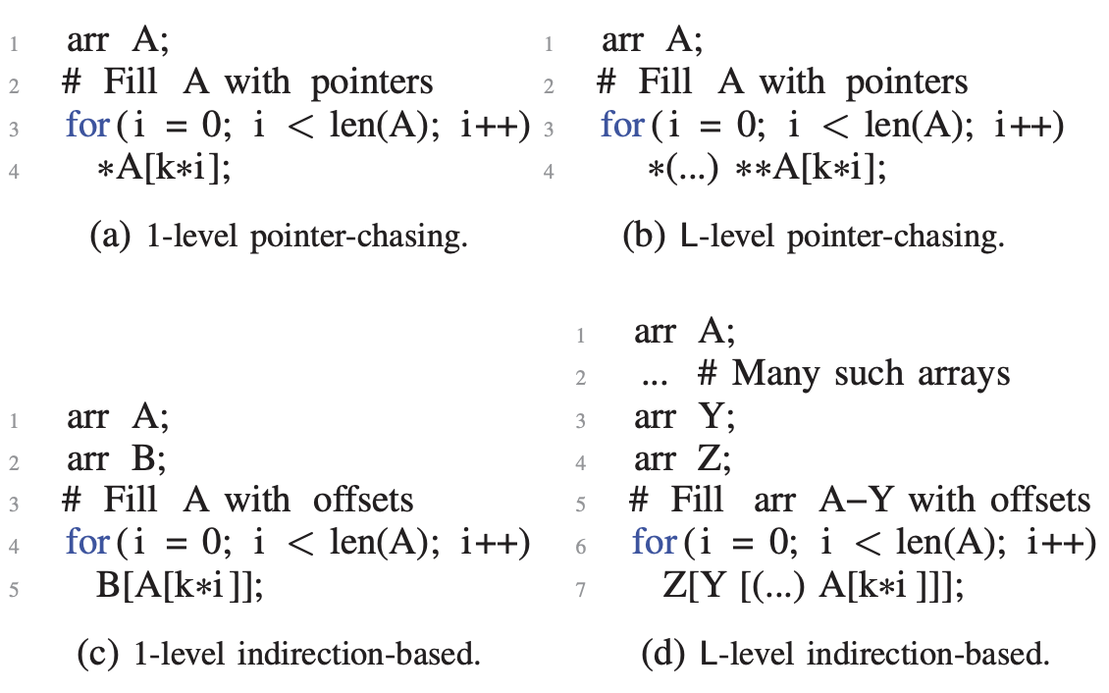
Data memory-dependent prefetcher - dmp
Classical Prefetchers will recognize the pattern A[k], A[2k] and prefetch A[3K]
DMP will also prefetch *A[3k]
There wasn’t evidence of any DMP in a commercial processor.
Notes:
כדי להצליח את
C
הוא צריך לדעת איפה מערך
B
מתחיל בזיכרון ואז להוסיף לו את הערך מ
A
כדי לעשות חיזוי ערכי. פעולה מורכבת

Slide 15
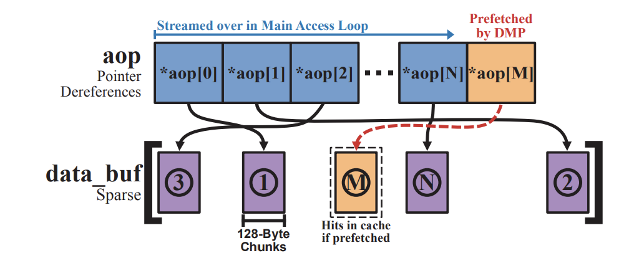
How to find a DMP in the wild
Expect *AoP[M] to be cached
Compare to baseline that computes addresses on the fly (prevent prefetching)
Both versions execute the same instructions sequence
Added dependencies to prevent OoOE

Slide 16
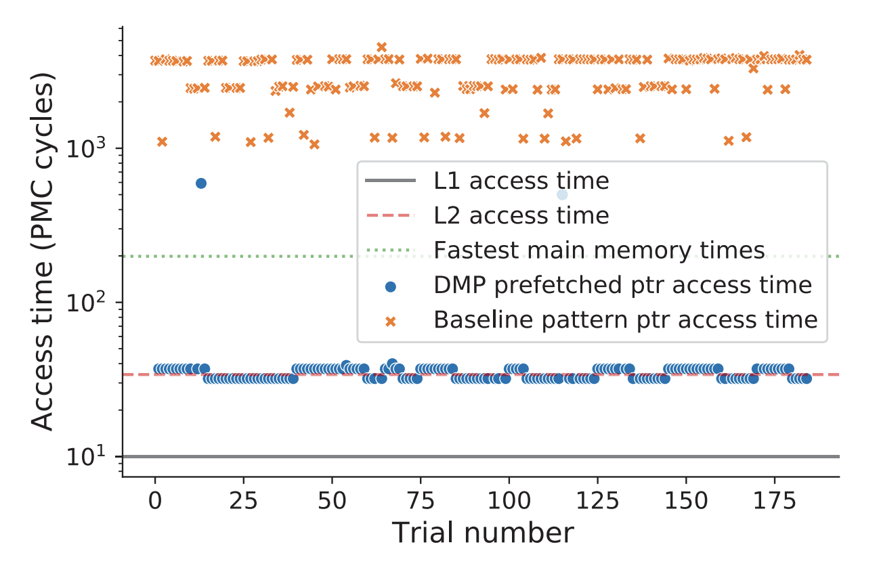
How to find a DMP in the wild

Slide 17
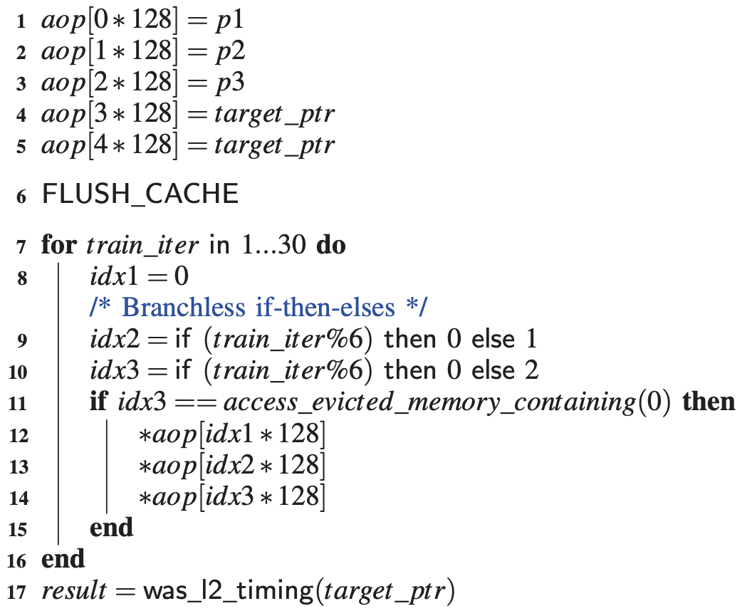
How to find a DMP in the wild
The if will take many clock cycles. Triggering a speculative execution
Showcase the first microarchitectural attack leaking data at rest

Slide 18
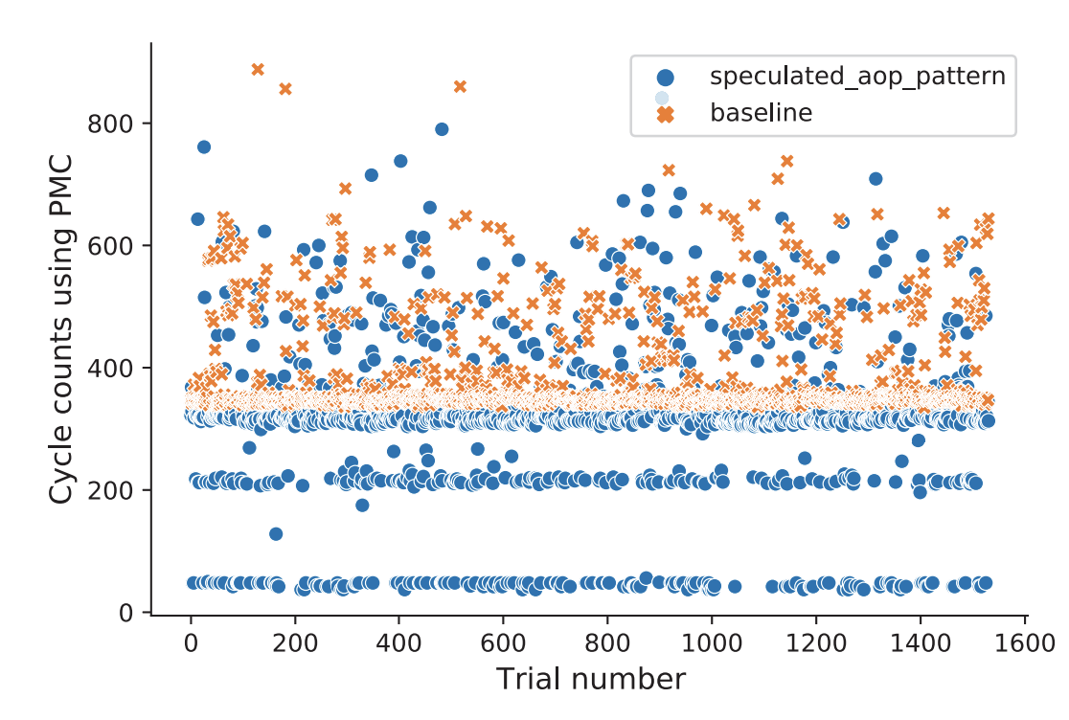
How to find a DMP in the wild
Baseline – without the three speculative accesses on each 6th train loop iteration
Notes:
כדי להצליח את
C
הוא צריך לדעת איפה מערך
B
מתחיל בזיכרון ואז להוסיף לו את הערך מ
A
כדי לעשות חיזוי ערכי. פעולה מורכבת

Slide 19
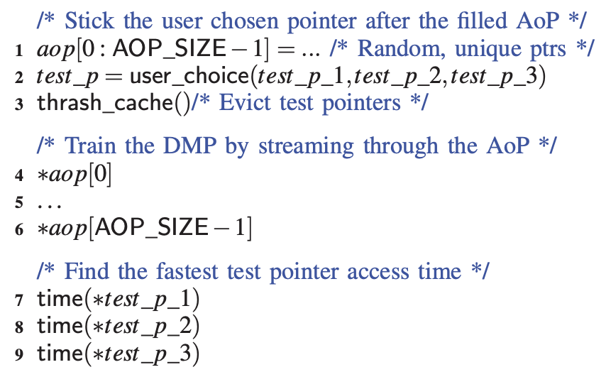
Attack poc
Start: Identifies 3 potential pointers at end of AoP
End: Attacker knows which pointer was picked by the user.
If attacker can’t access pointers – Prime+Probe them!
Notes:
Can thrash cache by reads huge amounts of unrelated data to fill up the cache.

Slide 20
Attack poc
DMP requires 3 accesses that match the AoP pattern to activate
Can test with p3 if certain virtual address is valid user mapped memory. Use this to break ASLR!
Notes:
Can thrash cache by reads huge amounts of unrelated data to fill up the cache.

Slide 21
Mitigation
Can’t simply “disable DMP”
Move to Icestorm cores
Remove sensitive information from virtual address of an untrusted user program (Chrome’s Site Isolation, KPTI/KAISER)
Manipulate observed DMP behavior (Hide in dead zones, avoid 8-byte alignment pointers)
Notes:
Firestorm cores are Apple's high-performance CPU cores, designed for demanding tasks, while Icestorm cores are smaller, highly efficient cores for background and less intensive work, both found in the M1 chip, differing mainly in their power-vs-performance balance, with Firestorm delivering raw speed and Icestorm maximizing battery life and low heat, creating a powerful yet efficient system

Slide 22
Personal view
Good:
First discovery of a DMP in the wild.
Very strong – even untouched secret isn’t safe
Impressive methodology

